Slide 1
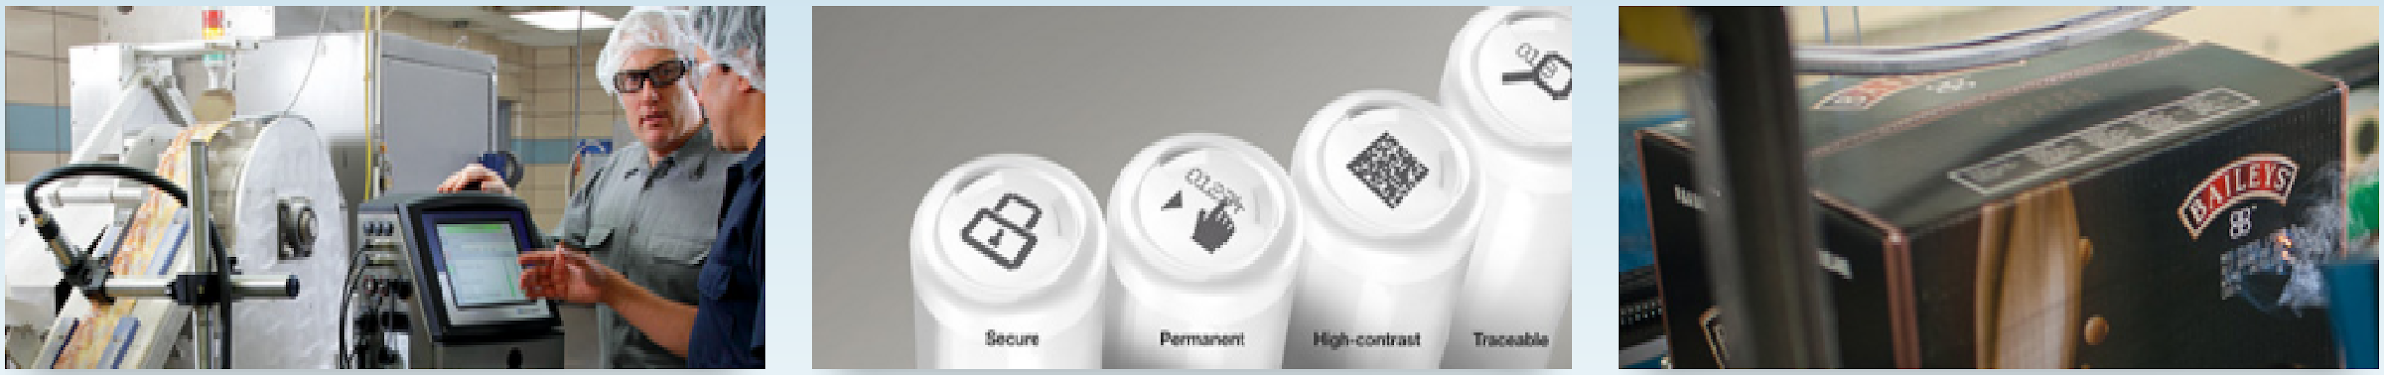

Churn Analytics Project with USC
July 2020

Slide 2
AB4J
Team | First Name | Last Name
AB4J | Jinney | Guo
AB4J | Binzi (Joycy) | Liu
AB4J | Jenny | Wang
AB4J | Jie | Ji
AB4J | Shih-Hung (Angela) | Ma
AB4J | Shringar | Sharan

Slide 3
Customer Segmentation

Slide 4
Customer Segmentation Summary
Customer are segmented based on their Number of Purchases (Frequency), Total Amount Spent (Monetary), and Number of days with the company (Duration)
Key Attributes | Tier 1 | Tier 2 | Tier 3 | Tier 4 | Total
Customer size | 3,513 | 5,634 | 4,362 | 2,901 | 16,410
Avg Number of Purchase | 84.8 | 19.5 | 4.5 | 1.1 | 26.2
Avg Total Amount Spent | 112,031 | 10,008 | 1,798 | 618 | 28,007
Avg Duration (in Days) | 1,751 | 1,386 | 613 | 2 | 1,014
% of sales (based on 2019 sales) | 85.14% | 12.68% | 1.78% | 0.4% | 100%
Churn Rate | 7.91% | 22.31% | 52.82% | 78.42% | 36.21%
We used clusters of 4 from K-means because it has a relatively low sum of squared error and have higher silhouette score compared to other clustering method (ex: Hierarchical clustering)
Tier 1 are the most loyal and valuable customers with the company, they make more transactions, spend the most per site, stay around 5 years with the company, and contribute the most to the company’s revenue (85% of total revenue in 2019)
Tier 3 are relatively new customers with the company who spent around 2 years with the company and have the potential to become long-term customer

Slide 5
Churn Model

Slide 6
AB4J –Churn Model
Model Summary:
The main idea: given customer attribution and past behavior, would the customer continue make transaction in next 12 month?
Target Variable: Whether Customer would “Churn” in the next 12 months
The data would be divided into 2 period: Target period and Feature period
The data on Target period will not be included when calculating the features such as Monetary (Total Amount Spent) or Frequency (Number of Purchase)
Our team used Logistic Regression to predict churn/inactivity
Churn Model for Tier 4 Customer is unnecessary since they are either 1-time buyer or newly-join customers

Slide 7
AB4J – Churn Model
2015-01-01
2019-06-01
2020-06-01
1
Feature Period
Target Period
1. Conduct 10-fold cross validation to choose the best hyper-parameter
2. Conduct feature selection to find the most important feature
2015-01-01
2020-06-01
2021-06-01
2
The Data fed into the Model
Predict whether customer would be inactive in the next 12 months
After building the model based on first timeframe, all latest data (shown as “The Data Feed into Model) would be fed into the model to predict customer churn for the next 12 month periods

Slide 8
AB4J –Churn Model
Model Characteristic:
Dynamic: The model can be updated overtime when more data are available
Flexible: The length of “Target Period” can also be changed to suit company’s need. For example, changing the length from 12 months to 6 months when studying Tier 1 (Most Valuable) customer
Customize : Feature selection can be conducted for different time and per Customer Tier
Automated: After setting the timeframe for “Target Period” and “Feature Period”, the algorithm could go through model building, feature selection, and prediction automatically

Slide 9
AB4J –Churn Model
Model Selection Criteria:
Hyper-parameter: Based on 10-fold Cross Validation, choose the combination of hyper-parameters that return the highest recall rate, then the highest accuracy rate, then the highest f1 score
The underlying assumption for this method: It is costly for the company to not identify which customers would become inactive(churn) compared to treating customers as if they would churn when they actually won’t
Features: Using both “Select From Model”(SFM) and “Recursive Feature Elimination” (RFE) to select the most important feature for model

Slide 10
Team AB4J – Key factors impacting customer churn
Key Factors and Example are based on the following model
Target Period: 2019-06-02 to 2020-06-03 / Feature Period: 2015-01-01 to 2019-06-01
Key Factors |  | Cluster 1 |  |  | Cluster 2 |  |  | Cluster 3
 |  | Rank | Coef | Avg Value | Rank | Coef | Avg Value | Rank | Coef | Avg Value
1 | Recency | 1 | + | 60.21 | 1 | + | 187.17 | 1 | + | 539.49
2 | Visit_per_TRX | 2 | - | 0.56 | 2 | - | 1.05 | 4 | - | 2.48
3 | Contract | 3 | - | 5.77
4 | Customer_Class_OEM | 4 | - | 0.007
5 | Main_Product_TTO | 5 | + | 0.08
6 | Frequency |  |  |  | 3 | + | 15.86 | 2 | + | 3.74
7 | Avg_AMT |  |  |  | 4 | + | 598.71 | 5 | + | 437.48
8 | Latest_Amt_Ratio |  |  |  | 5 | - | 1.11
9 | Avg_Duration |  |  |  |  |  |  | 3 | + | 123.87
Number of Sites |  | 3,350 |  |  | 5,019 |  |  | 3,298
Avg Purchase frequency (Days) (based on 2015-2019 data) |  | 30.29 |  |  | 83.73 |  |  | 123.87
% of sales (based on 2019 sales) |  | 85.14% |  |  | 12.68% |  |  | 1.78%
Churn Rate (Inactive in the past 1 year) |  | 7.67% |  |  | 21.26% |  |  | 59.58%

Slide 11
Team AB4J – Churn Prediction summary for each Tier
Model Summary
Target Period: 2019-06-02 to 2020-06-03 / Feature Period: 2015-01-01 to 2019-06-01
Model Metric are the average of 10-fold cross validation
80% of data for training and 20% data for testing
Model Metrics | Cluster 1 | Cluster 2 | Cluster 3
Number of Sites | 3,350 | 5,019 | 3,298
Churn Rate | 7.67% | 21.26% | 59.58%
Accuracy | 95.94% | 88.03% | 75.14%
Precision | 86.28% | 84.45% | 79.97%
Recall | 56.02% | 54.64% | 82.90%
F1 Score | 67.72% | 65.47% | 79.24%
Accuracy:
The ratio of number of customers the model predicted would churn vs all customers in the dataset
Precision:
Of all customers the model predicted would churn, how many actually did churn
… high rate = low false positive results
Recall:
Of all customers that truly churned, how many did the model predict would churn
F1:
Weighted average of precision and recall

Slide 12
Team AB4J – List of Customers that will likely Churn by Cluster / Customer Group
Key Attributes | Cluster 1 | Cluster 2 | Cluster 3
Customer size | 3,391 | 5,195 | 3,810
Predicted Inactive Customer for 2020-2021 | 218 | 787 | 2,332
Predicted Inactive Rate | 6.43% | 15.15% | 61.21%
Customer that are active now but may churn next year | 4 | 6 | 452
Customer size | 3,350 | 5,019 | 3,298
Inactive Customer during 2019-2020 | 250 | 1,052 | 1,978
Inactive Rate | 7.67% | 21.26% | 59.58%
Some of the current (2019-2020) inactive customers are included in the predicted inactive customer for next year
The model implies that some of the current inactive customer may become active in the next year
The growing number of customer size is largely due to more data are qualified to enter the model (all necessary features can be calculated)

Slide 13
List of Customers that will likely Churn by Tier 1
4 Tier 1 Customers that are active in the past year but may churn in the next year
CUSTOMER_SITE_ID
9949
24190
63817
112402

Slide 14
List of Customers that will likely Churn by Tier 2
9 Tier 2 Customers that are active in the past year but may churn in the next year
CUSTOMER_SITE_ID
12910
33594
367748
491145
534196
70320

Slide 15
List of Customers that will likely Churn by Tier 3
452 Tier 3 Customers that are active in the past year but may churn in the next year
CUSTOMER_SITE_ID
1433 | 2305 | 3459 | 4534 | 5355 | 7744 | 8840 | 8905 | 9045 | 9134 | 24205 | 27084 | 27098 | 32673 | 33989 | 34148
34568 | 42190 | 42256 | 42279 | 43095 | 61513 | 64946 | 65151 | 65718 | 67815 | 69014 | 69755 | 77596 | 78429 | 82650 | 83458
86252 | 91336 | 91577 | 95036 | 100183 | 100365 | 102198 | 105396 | 112971 | 113138 | 116067 | 117804 | 121507 | 121879 | 123897 | 146930
154362 | 155266 | 156795 | 157177 | 159889 | 160403 | 160687 | 164748 | 168228 | 174103 | 174349 | 184839 | 187198 | 192387 | 192917 | 196055
196274 | 197411 | 204933 | 227852 | 230069 | 231460 | 234271 | 240619 | 250264 | 256684 | 258196 | 258647 | 263721 | 268037 | 280159 | 281809
307743 | 307866 | 313921 | 315974 | 318104 | 318435 | 318989 | 319506 | 323109 | 323158 | 329159 | 333742 | 336490 | 352461 | 356530 | 362826
363070 | 364121 | 365711 | 369706 | 373216 | 375487 | 389326 | 392889 | 393440 | 397974 | 443568 | 453846 | 466528 | 467109 | 478400 | 479526
479893 | 480185 | 480319 | 481148 | 489884 | 499013 | 517304 | 522713 | 523630 | 529066 | 530350 | 543106 | 543645 | 544520 | 550065 | 550528
552521 | 553930 | 558467 | 558539 | 564181 | 564541 | 567420 | 570985 | 579961 | 583846 | 589826 | 594392 | 594854 | 595404 | 597977 | 597979
602343 | 608117 | 609621 | 611285 | 613776 | 614697 | 630065 | 633736 | 639719 | 642286 | 647013 | 660700 | 662346 | 663879 | 664632 | 666917
684726 | 691102 | 693128 | 693679 | 697463 | 698828 | 705679 | 713308 | 714321 | 717587 | 726719 | 731059 | 731090 | 735683 | 738067 | 744000
746758 | 749071 | 752541 | 755948 | 760536 | 763023 | 767900 | 779748 | 781368 | 784079 | 784785 | 785714 | 786434 | 787945 | 789906 | 793641
795511 | 795952 | 797596 | 803784 | 816739 | 817905 | 818370 | 818574 | 820150 | 863202 | 896999 | 900859 | 904765 | 904781 | 946027 | 1060493
1104704 | 1167070 | 1885368 | 1929340 | 2379524 | 2396802 | 2402601 | 2430989 | 2459803 | 2597406 | 2603034 | 2694364 | 2819850 | 2820549 | 2821862 | 2824874
3161263 | 3483106 | 3553754 | 3665608 | 3724607 | 3960476 | 4105368 | 4398529 | 4527017 | 4587612 | 5007277 | 5467236 | 5857654 | 6051252 | 6230068 | 6305474

Slide 16
List of Customers that will likely Churn by Tier 3
452 Tier 3 Customers that are active in the past year but may churn in the next year
CUSTOMER_SITE_ID
6426199 | 6486293 | 6821037 | 6858928 | 6866495 | 7195749 | 7693032 | 7897201 | 8008046 | 8023877 | 8303572 | 8305992 | 8307488 | 8313469 | 8314566 | 8321616
8323681 | 8323806 | 8327986 | 8331376 | 8332063 | 8332495 | 8333454 | 8333808 | 8338135 | 8340675 | 8346620 | 8347672 | 8359077 | 8360771 | 8361280 | 8372336
8373525 | 8376439 | 8382664 | 8390179 | 8402525 | 8403329 | 8403888 | 8408287 | 5435 | 5508 | 5784 | 6146 | 6847 | 7023 | 8239 | 24157
25921 | 27804 | 32579 | 33714 | 34522 | 35124 | 40186 | 41387 | 42089 | 49961 | 62362 | 64558 | 66104 | 66168 | 69401 | 70343
72781 | 73373 | 73735 | 73806 | 81317 | 84495 | 86556 | 86651 | 88731 | 90153 | 92663 | 96563 | 97743 | 104020 | 105054 | 110467
112351 | 115710 | 118321 | 119189 | 119212 | 122693 | 123471 | 146544 | 147119 | 151600 | 154326 | 158009 | 161370 | 170011 | 175978 | 184866
188494 | 189804 | 193133 | 229512 | 234329 | 269343 | 270390 | 282528 | 284916 | 289121 | 311021 | 315501 | 333818 | 353195 | 361393 | 367793
370392 | 371835 | 372068 | 382694 | 388671 | 398082 | 460510 | 473908 | 488878 | 493985 | 498098 | 499131 | 500424 | 521362 | 522441 | 522877
533405 | 542484 | 544528 | 547063 | 547630 | 568805 | 572650 | 573431 | 593992 | 608403 | 614705 | 616640 | 630339 | 637762 | 650039 | 655129
658133 | 659259 | 669609 | 672032 | 687822 | 719833 | 725861 | 727540 | 738073 | 745379 | 761289 | 782746 | 782900 | 794847 | 796887 | 800653
818388 | 916130 | 953704 | 1233942 | 1336408 | 1929313 | 1989897 | 2139747 | 2528619 | 2820787 | 2824791 | 3038503 | 3038794 | 3457652 | 3645465 | 3711347
3803425 | 4105349 | 4425519 | 4425520 | 4730515 | 5365767 | 5577181 | 5894897 | 6774990 | 7203609 | 7288356 | 7669324 | 8008147 | 8127506 | 8230880 | 8315990
8328042 | 8328402 | 8339586 | 8340757 | 8350141 | 8360629 | 8361142 | 8362176 | 8364205 | 8368110 | 8371541 | 8377265 | 8378560 | 8378632 | 8383032 | 8397197
8398667 | 8406846 | 8408894 | 8417628

Slide 17
Survival Analysis

Slide 18
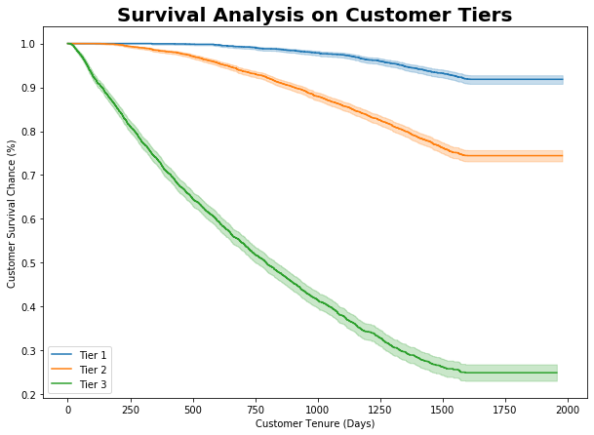
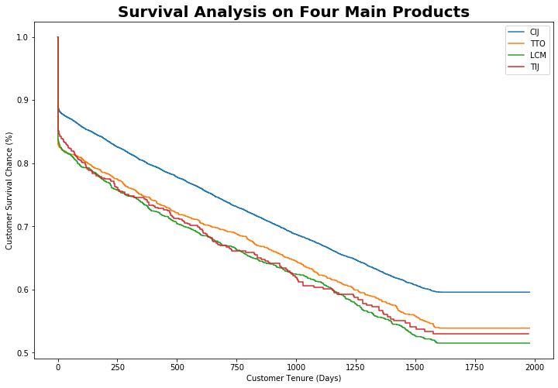
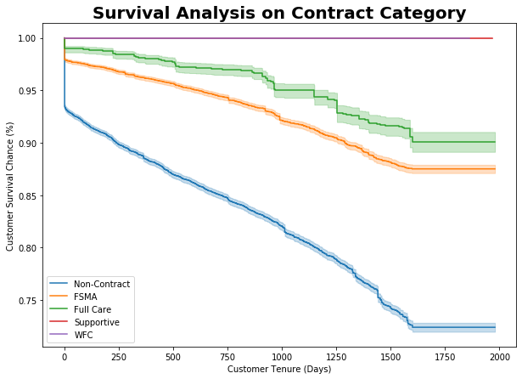
Team AB4J – Survival Analysis
By Customer Tiers
Product Families
Contract Category
Obvious difference in survival rate between the different customer tiers, but the curve will flatten at around 1500 days (around 4 years). In comparison, there is not a significant difference between the four main product families outside of CIJ, which seems to have the best survival rate.

Slide 19
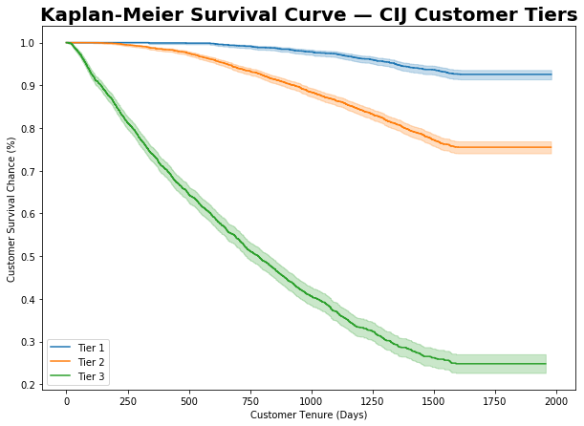
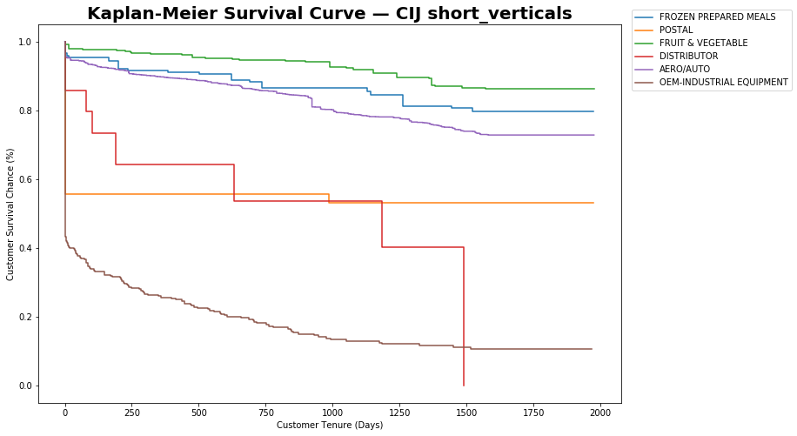
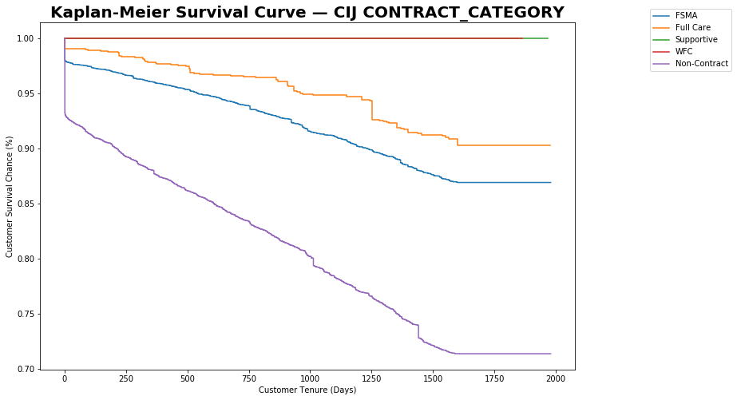
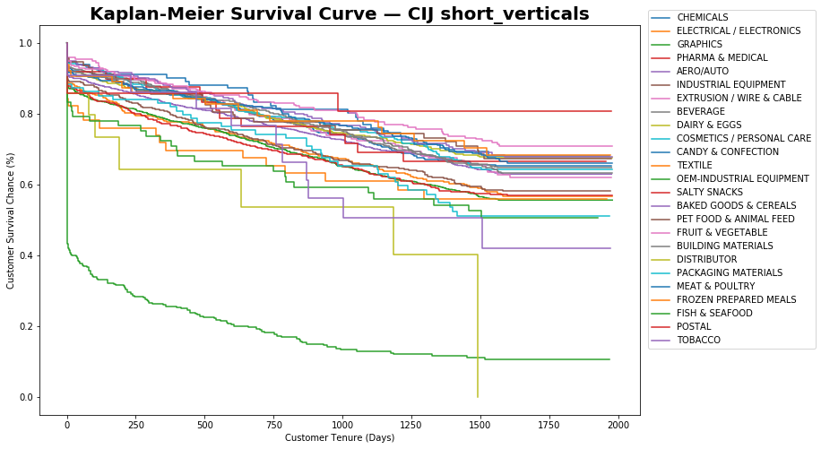
Team AB4J – Survival Analysis for CIJ
By Customer Tiers
By Short_Verticals
Top 3 most possible categories to not churn:
POSTAL
FRUIT & VEGETABLE
FROZEN PREPARED MEALS
Top 3 most possible categories to churn:
OEM-INDUSTRIAL EQUIPMENT
DISTRIBUTOR
AERO/AUTO
By Contract Category

Slide 20
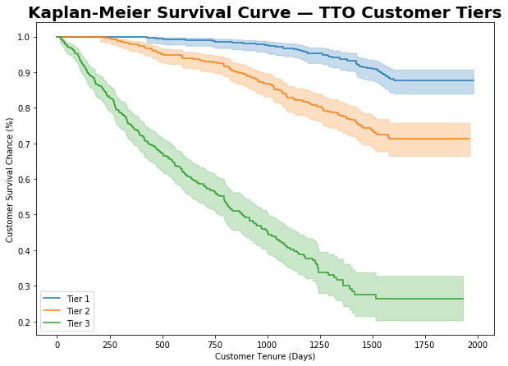
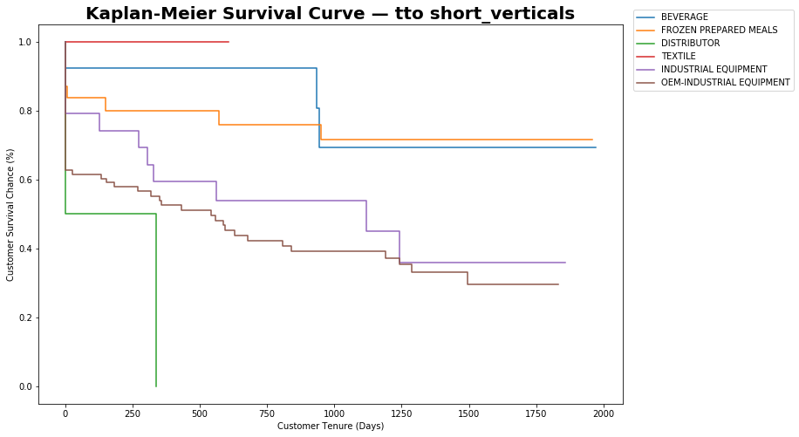
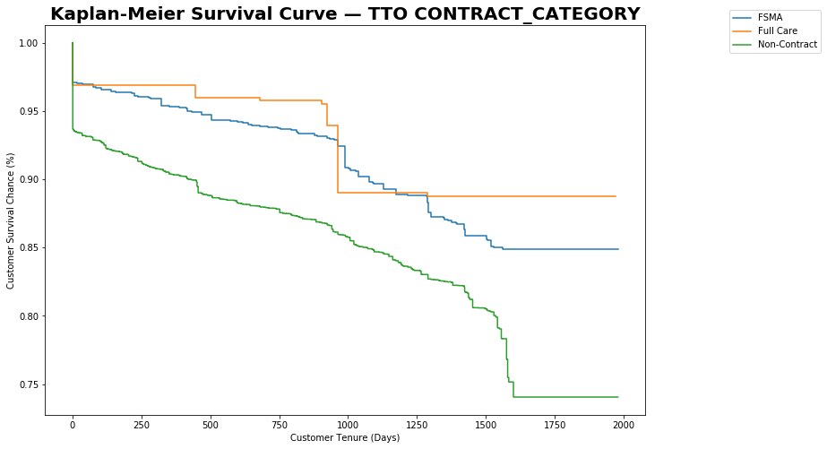
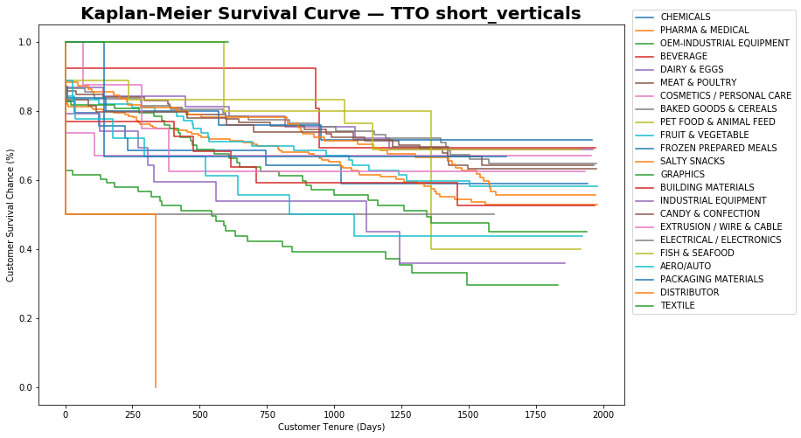
Team AB4J – Survival Analysis for TTO
By Customer Tiers
By Short_Verticals
Top 3 most possible categories to not churn:
TEXTILE
FROZEN PREPARED MEALS
BEVERAGE
Top 3 most possible categories to churn:
DISTRIBUTOR
OEM-INDUSTRIAL EQUIPMENT
INDUSTRIAL EQUIPMENT
By Contract Category

Slide 21
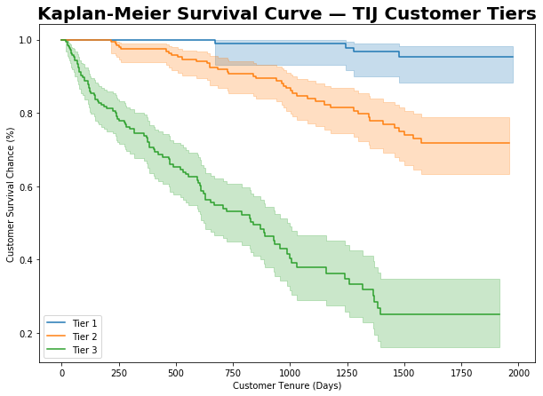
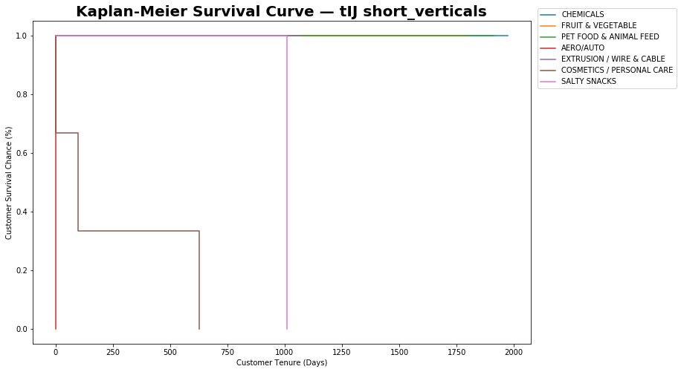
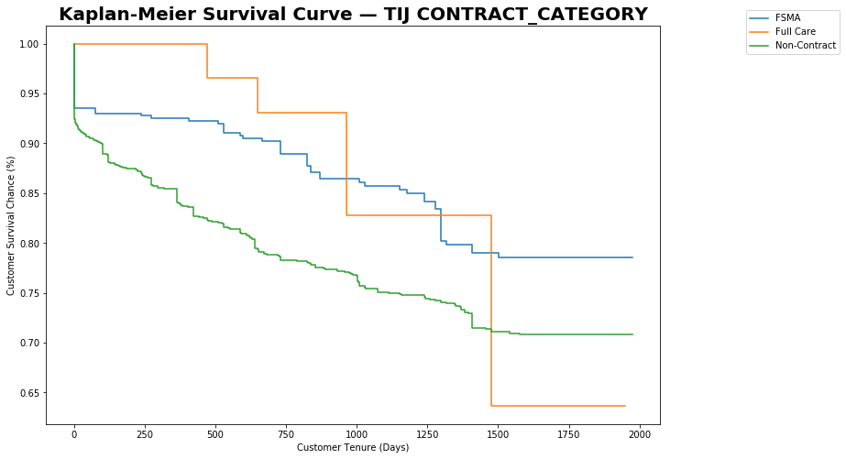
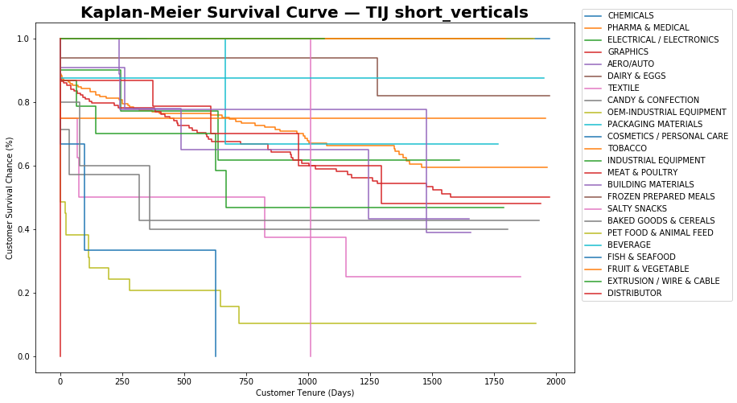
Team AB4J – Survival Analysis for TIJ
By Customer Tiers
By Short_Verticals
Top 4 most possible categories to not churn:
CHEMICALS
FRUIT & VEGETABLE
PET FOOD & ANIMAL FEED
EXTRUSION / WIRE & CABLE
Top 3 most possible categories to churn:
DISTRIBUTOR
COSMETICS / PERSONAL CARE
SALTY SNACKS
By Contract Category

Slide 22
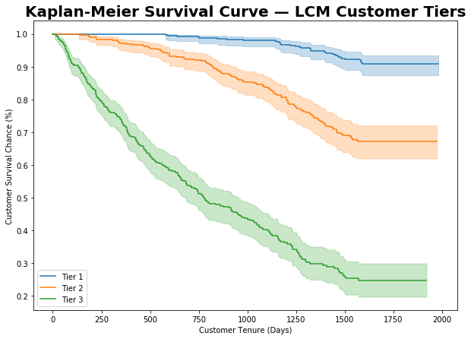
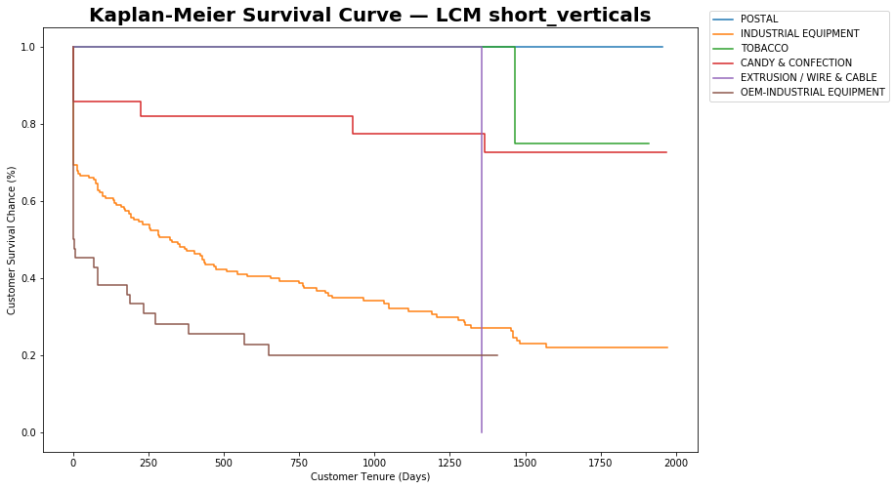
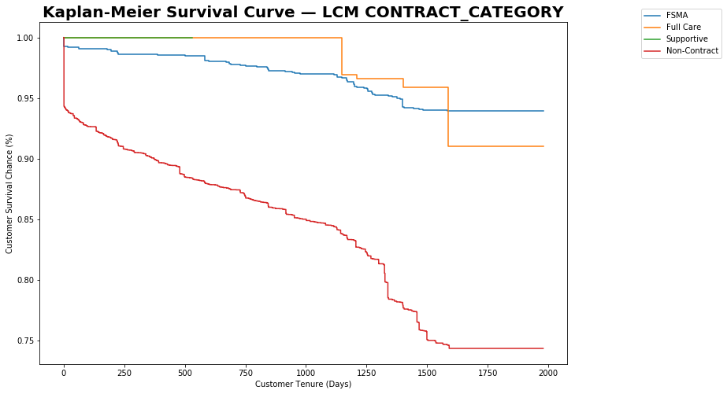
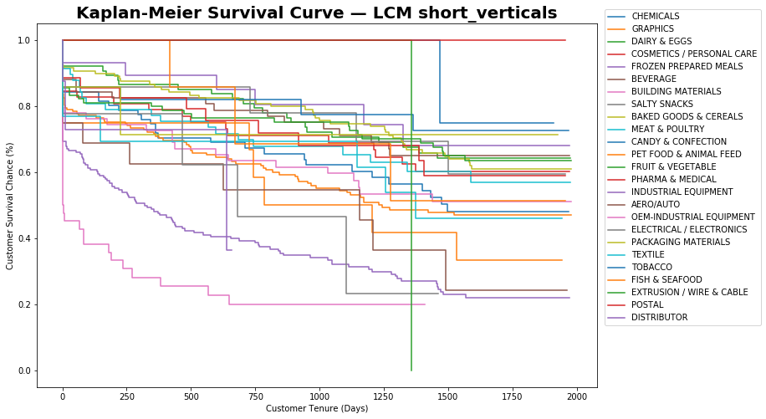
Team AB4J – Survival Analysis for LCM
By Customer Tiers
By Short_Verticals
Top 3 most possible categories to not churn:
POSTAL
TOBACCO
CANDY & CONFECTION
Top 3 most possible categories to churn:
EXTRUSION/ WIRE & CABLE
OEM-INDUSTRIAL EQUIPMENT
INDUSTRIAL EQUIPMENT
By Contract Category

Slide 23
Team AB4J – Price Index
 | Tier 1 | Tier 2 | Tier 3
Customer size | 3,350 | 5,019 | 3,298
Total Churn Rate | 7.67% | 21.26% | 59.58%
Price Index Cutoff Point | 1.605 | 0.923 | 0.919
Churn rate when Price Index above cutoff | 18.47% | 31.47% | 67.39%
The churn rate for each Tier above cut off point would be higher
The features “Price_Index” is not selected by any Churn Model, implying it is not the main churn trigger

Slide 24
Team AB4J – List of Factors Considered – Tier 1
Model Summary
Target Period: 2019-06-02 to 2020-06-03
Feature Period: 2015-01-01 to 2019-06-01
Model Summary
Feature Period: 2019-06-02 to 2020-06-03
Predict Period: 2020-06-04 to 2021-06-03
Variable | Rank | Coefs
Recency | 1 | 1.888095
Visit_per_TRX | 2 | -0.84942
Contract | 3 | -0.47857
CUSTOMER_CLASS_OEM | 4 | -0.45259
Main_Product_mode_TTO | 5 | 0.377213
NO_OF_SVC_INCIDENTS | 6 | 0.33155
Lastest_Amt_Ratio | 7 | -0.27597
SALES_CHANNEL_mode_Esker | 8 | 0.2242
Variable | Rank | Coefs
Recency | 1 | 1.089283
Visit_per_TRX | 2 | -0.28015
Lastest_Amt_Ratio | 3 | -0.27044
Contract | 4 | -0.11588
CUSTOMER_CLASS_OEM | 5 | -0.0929

Slide 25
Team AB4J – List of Factors Considered – Tier 2
Model Summary
Target Period: 2019-06-02 to 2020-06-03
Feature Period: 2015-01-01 to 2019-06-01
Model Summary
Feature Period: 2019-06-02 to 2020-06-03
Predict Period: 2020-06-04 to 2021-06-03
Variable | Rank | Coefs
Recency | 1 | 1.837899
Visit_per_TRX | 2 | -0.62214
Frequency | 3 | 0.384857
Avg_AMT | 4 | 0.345554
Lastest_Amt_Ratio | 5 | -0.25323
Main_Product_mode_CIJ | 6 | -0.05337
Variable | Rank | Coefs
Recency | 1 | 1.352892
Visit_per_TRX | 2 | -0.35819
Frequency | 3 | 0.249555
Avg_AMT | 4 | 0.246175
Lastest_Amt_Ratio | 5 | -0.20367

Slide 26
Team AB4J – List of Factors Considered – Tier 3
Model Summary
Target Period: 2019-06-02 to 2020-06-03
Feature Period: 2015-01-01 to 2019-06-01
Model Summary
Feature Period: 2019-06-02 to 2020-06-03
Predict Period: 2020-06-04 to 2021-06-03
Variable | Rank | Coefs
Recency | 1 | 1.152064
Frequency | 2 | 0.38673
Avg_Duration | 3 | 0.316605
Visit_per_TRX | 4 | -0.23013
Avg_AMT | 5 | 0.229124
CUSTOMER_CLASS_OEM | 6 | 0.19669
Variable | Rank | Coefs
Recency | 1 | 1.202607
Frequency | 2 | 0.373147
Avg_Duration | 3 | 0.32351
Avg_AMT | 4 | 0.28908
Visit_per_TRX | 5 | -0.24478
CUSTOMER_CLASS_OEM | 6 | 0.210207
NO_OF_SVC_INCIDENTS | 7 | 0.167414

